Slide 1
Module-3
Ordinary Least Squares , Correlation , Multiple Regression

Slide 2
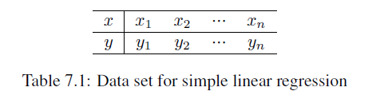
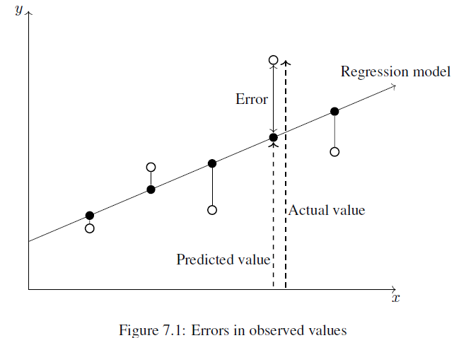
Ordinary Least Squares

Slide 3
In order to determine the optimal estimates of α and β, an estimation method known as ordinary least squares (OLS) was used.
In OLS regression, the slope and intercept are chosen such that they minimize the sum of the squared errors, that is, the vertical distance between the predicted y value and the actual y value.
These errors are known as residuals, and are illustrated for several points in the above diagram

Slide 4

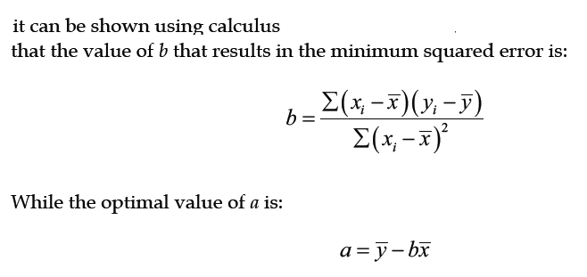
In mathematical terms, the goal of OLS regression can be expressed as the task of minimizing the following equation:
This equation defines e (the error) as the difference between the actual y value and the predicted y value. The error values are squared and summed across all points in the data.

Slide 5

Correlations
The correlation between two variables is a number that indicates how closely their relationship follows a straight line. Without additional qualification, correlation refers to Pearson's correlation coefficient, which was developed by the 20th century mathematician Karl Pearson. The correlation ranges between -1 and +1. The extreme values indicate a perfectly linear relationship, while a correlation close to zero indicates the absence of a linear relationship.
The following formula defines Pearson's correlation:

Slide 6
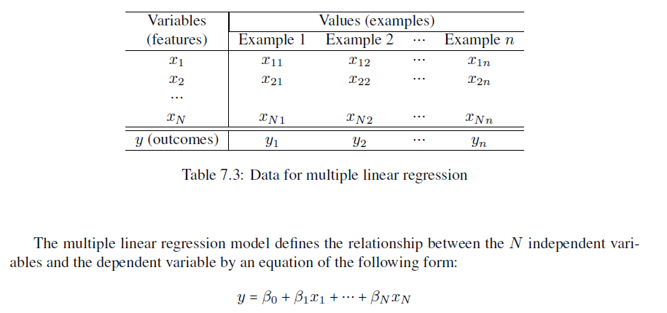
Multiple Regression

Slide 7
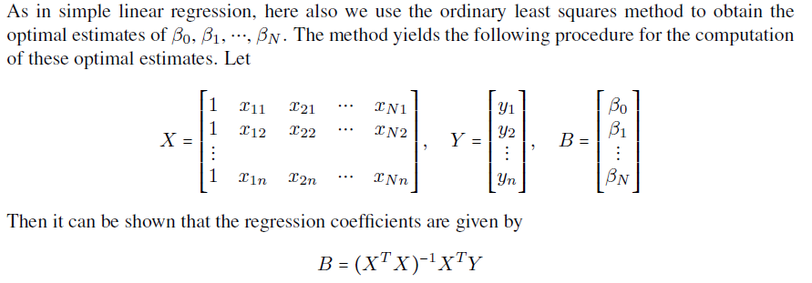

Slide 8
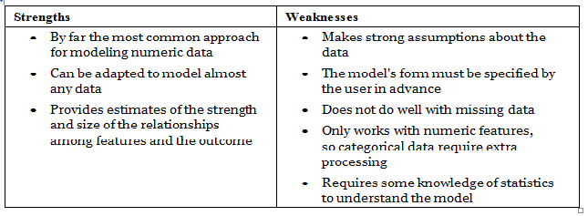

Slide 9
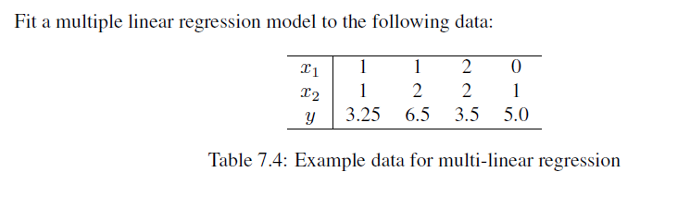
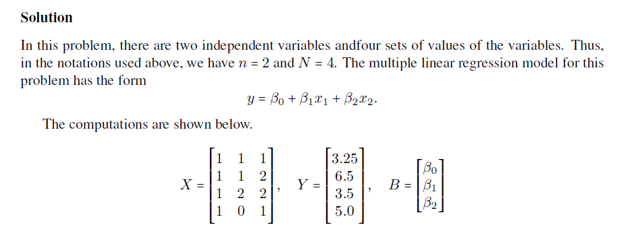
Problem

Slide 10


